Slide 1
Struktur Data
GRAPH:
REPRESENTASI, TRAVERSAL

Slide 2
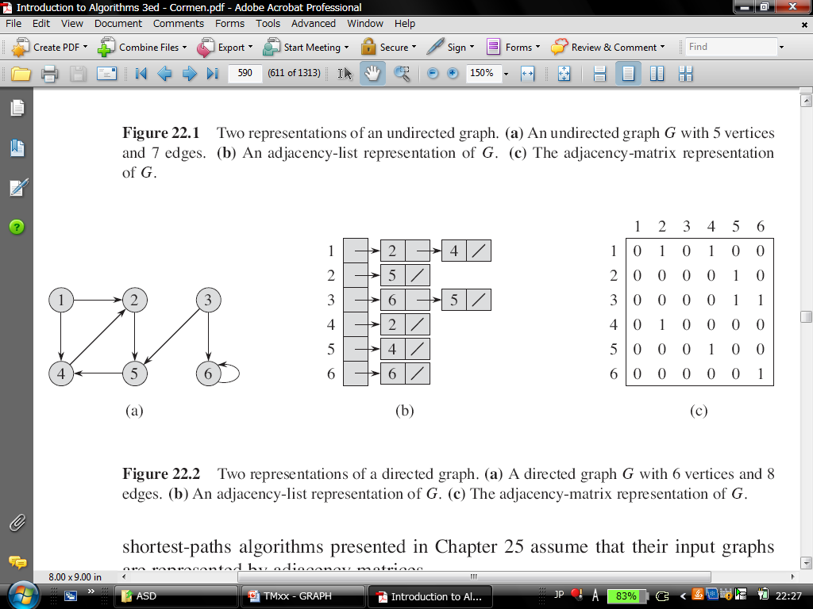
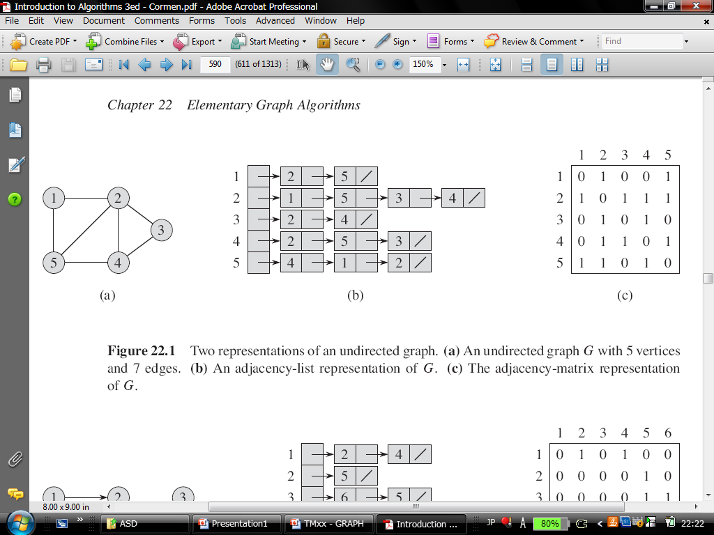
Representasi Graph: adjacency matrix
UNDIRECTED
INPUT:
6
2 2 4
1 5
2 5 6
1 2
1 4
1 6
UNDIRECTED
INPUT:
5
2 2 5
4 1 3 4 5
2 2 4
3 2 3 5
3 1 2 4

Slide 3
Representasi Graph: adjacency list
INPUT:
5
2 2 5
4 1 5 3 4
2 2 4
3 2 5 3
3 4 1 2
UNDIRECTED
INPUT:
6
2 2 4
1 5
2 6 5
1 2
1 4
1 6
UNDIRECTED

Slide 4
Penelusuran Graph (traversing)
Breadth-First Search (BFS)
Prioritas saudara daripada anak
Menggunakan bantuan struktur data queue
Depth-First Search (DFS)
Prioritas anak daripada saudara
Menggunakan bantuan struktur data stack
while (stack/queue is not empty) { print top/front node from the stack/queue; put all unvisited children of node onto the stack/queue; }

Slide 5
Breadth-First Search (BFS)
3 //queue
[3] 2 4
[3, 2] 4 1 5
[3, 2, 4] 1 5
[3, 2, 4, 1] 5
[3, 2, 4, 1, 5]
3
2
1
5
4
2
3
4
5
3
2
5
4
1
2
BFS(3)= 3 2 4 1 5

Slide 6
Depth-First Search (DFS)
3
2
1
2
5
4
2
5
3
1
2
5
3
4
4
3 //stack
4 2 [3] //top
4 5 1 [3, 2]
4 5 [3, 2, 1]
4 [3, 2, 1, 5]
[3, 2, 1, 5, 4]
BFS(3)=
3 2 1 5 4

Slide 7
Representasi Graph: adjacency list dengan linked-list
typedef struct node{
char data;
node *left;
node *right;
};
int main(){ //representasi binary tree
node *root = NULL;
insertTreeNode(&root,'F');
..........
//representasi graph, INGAT tree adalah kasus khusus dari graph
typedef struct node{
char data;
node *vertex;
node *edge;
};
int main(){ //representasi graph
node *graph = NULL;
makeGraph(&root);
..........

Slide 8
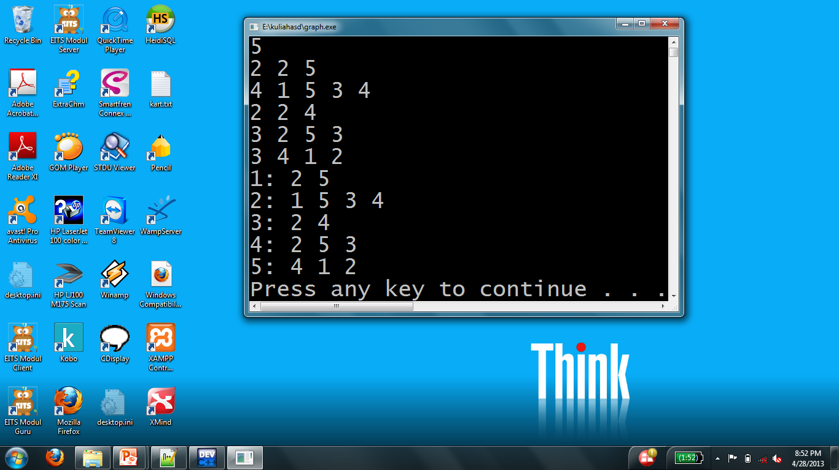
Buat Graph dengan STL
#include <iostream>
#include <vector>
using namespace std;
typedef vector<int> vi;
typedef vector<vi> graph;
int main(){
graph g;
makeGraph(g);
printGraph(g);
system("PAUSE");
return 0;
}
makeGraph(g);
printGraph(g);

Slide 9
Buat Graph dengan STL
void makeGraph(graph &g){
int numE, numV, vName;
scanf("%d", &numV);
while(numV--){
scanf("%d", &numE);
vi edge;
while(numE--){
getchar();
scanf("%d", &vName);
edge.push_back(vName);
}
g.push_back(edge);
}
}
INPUT:
5
2 2 5
4 1 3 4 5
2 2 4
3 2 3 5
3 1 2 4

Slide 10
Buat Graph dengan STL
void printGraph(graph g){
for(int j = 0; j < g.size(); j++){
printf("%d: ", j+1);
vi temp = g[j];
for(int k = 0; k < temp.size(); k++)
printf("%d ", temp[k]);
printf("\n");
}
}

Slide 11
Implementasi BFS dengan STL
#include <iostream>
#include <vector>
#include <queue>
using namespace std;
typedef vector<int> vi;
typedef vector<vi> graph;
int main(){
...
graph g;
makeGraph(g);
bfs(g, 3);
...
}

Slide 12
void bfs(graph g, int start){
vector<bool> visited;
for(int j = 0; j < g.size(); j++)
visited.push_back(false);
queue<int> q;
visited[start-1] = true;
q.push(start);
while(!q.empty()){
int checked = q.front();
q.pop();
printf("%d ", checked);
vi edge = g[checked-1];
for(int j = 0; j < edge.size(); j++)
if (visited[edge[j]-1] == false){
visited[edge[j]-1] = true;
q.push(edge[j]);
}
}
printf("\n");
}

